Slide 1
FLIPROBO TECHNOLOGIES
FAKE NEWS DETECTION PROJECT

Slide 2
PROBLEM STATEMENT
Business Problem Framing
A fake news may contain sentences that are usually hoaxes and spread through social media or various other online platforms. Such news items may contain false and/or exaggerated claims, and may end up being vitalized by algorithms, and users may end up in a filter bubble. They may or may not contain spam words.
Conceptual Background of the Domain Problem
The idea of fake news is not a novel concept. The idea has been in existence even before the emergence of the Internet as publishers used false and misleading information to further their interests. Following the advent of the web, more and more consumers began forsaking the traditional media channels used to disseminate information for online platforms. Not only does the latter alternative allow users to access a variety of publications in one sitting, but it is also more convenience and faster. The development, however, came with a redeﬁned concept of fake news as content publishers began using what has come to be commonly referred to as a clickbait.

Slide 3
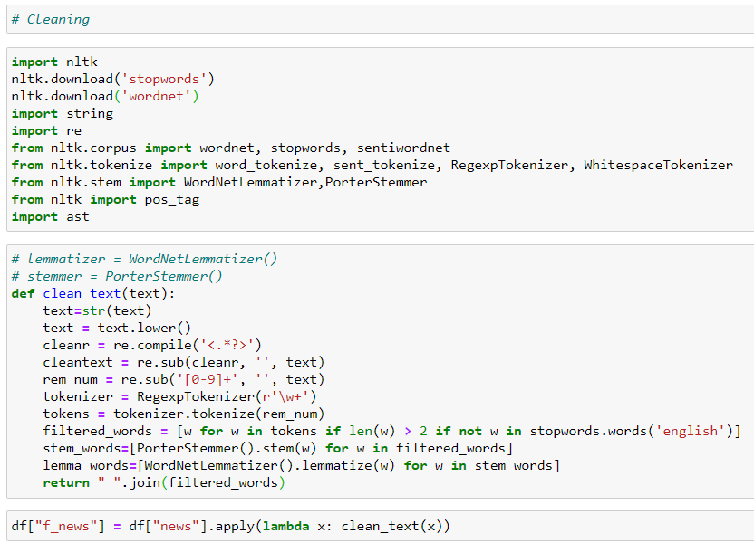
DATA PRE-PROCESSING
For Data pre-processing we did some data cleaning, where we used wordNet lemmatizer and porterStemmer to clean the words and removed special characters using Regexp Tokenizer and filter the words by removing stop words and then used lemmatizers and joined and return the filtered words.

Slide 4
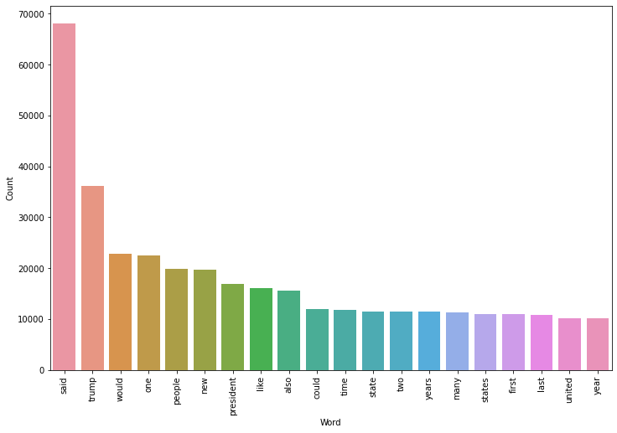
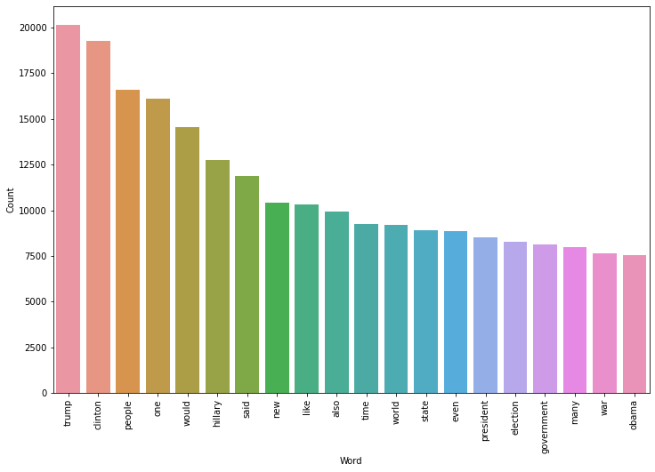
DATA INPUT- LOGIC-OUTPUT RELATIONSHIPS
Real Words Count
Fake Words Count

Slide 5
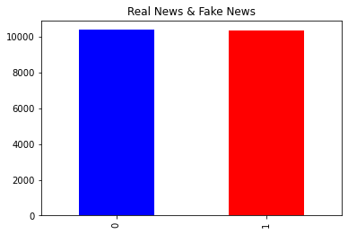
MODEL/S DEVELOPMENT AND EVALUATION
From the above we can see that the dataset is balanced which is good as it will help our model to classify more accurately, so we should expect good accuracy score, and as the volume of data was also good.

Slide 6
MODEL/S DEVELOPMENT AND EVALUATION
Testing of Identified Approaches (Algorithms)
Logistic Regression
Decision Tree Classifier
MultinomialNB
Random Forest Classifier
Pasive Aggressive Classifier

Slide 7
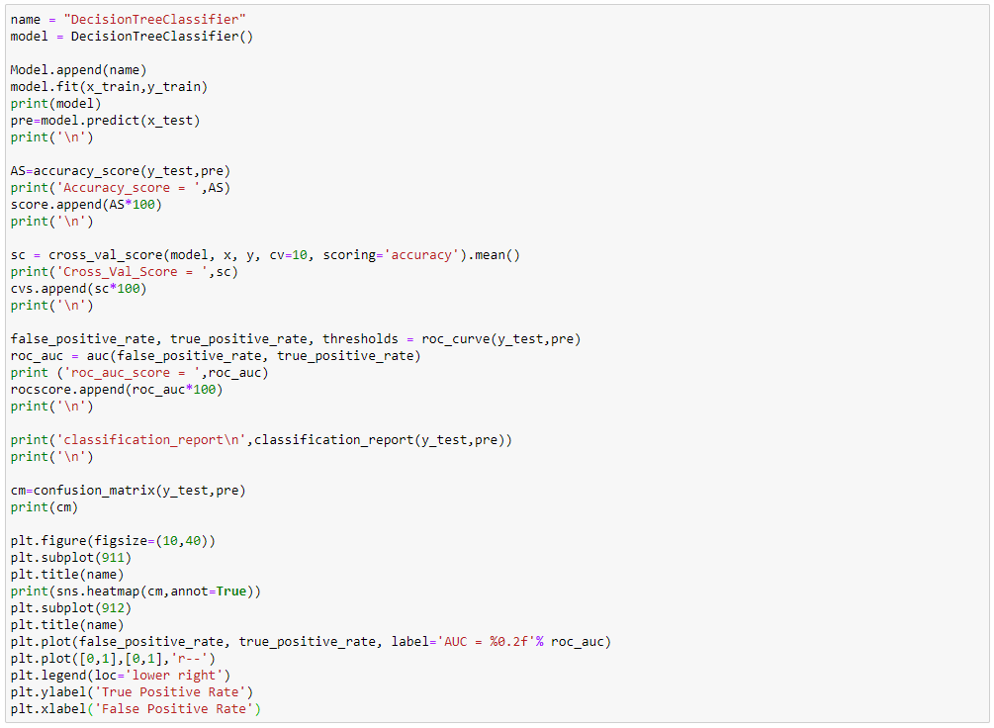
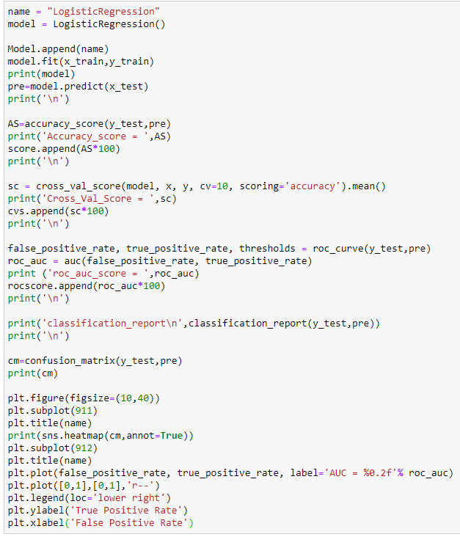
MODEL/S DEVELOPMENT AND EVALUATION
Run and Evaluated Some Selected models

Slide 8
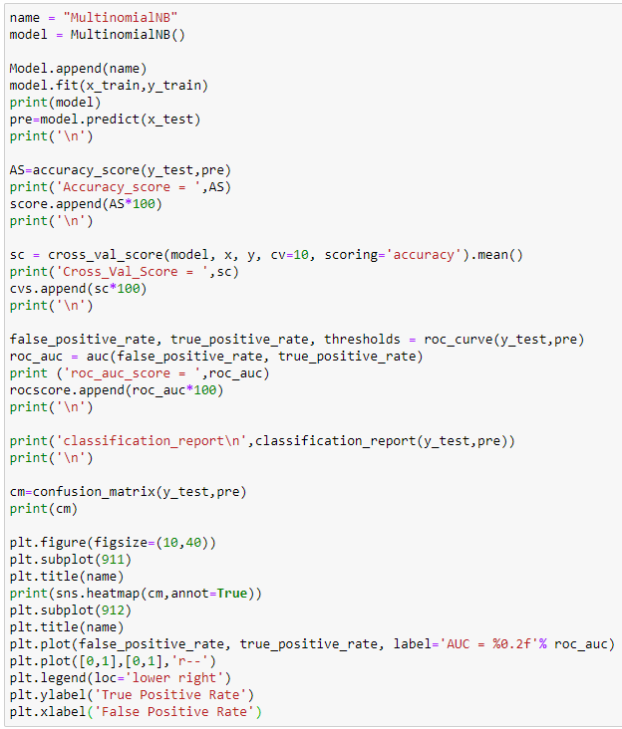
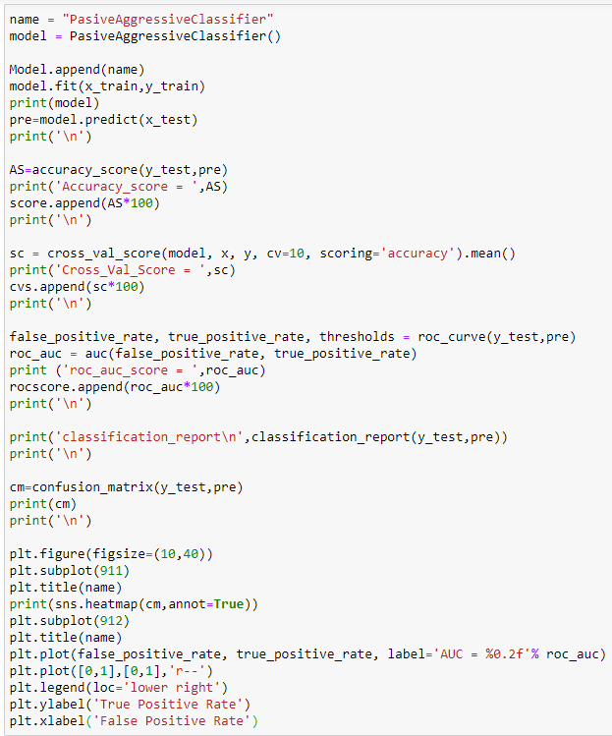

MODEL/S DEVELOPMENT AND EVALUATION

Slide 9
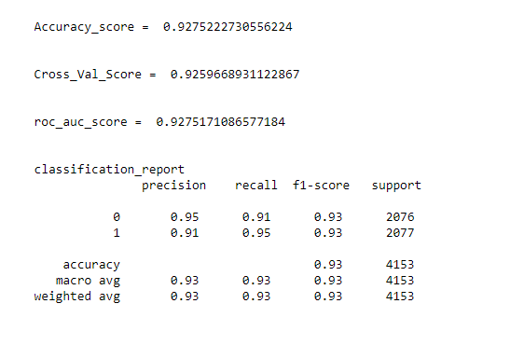
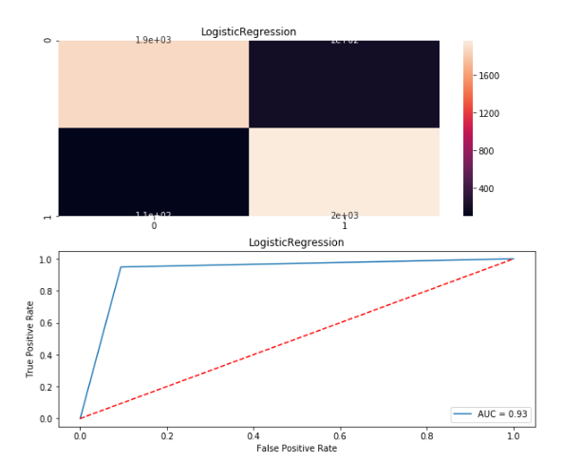
MODEL/S DEVELOPMENT AND EVALUATION
Logistic Regression Visualization:

Slide 10
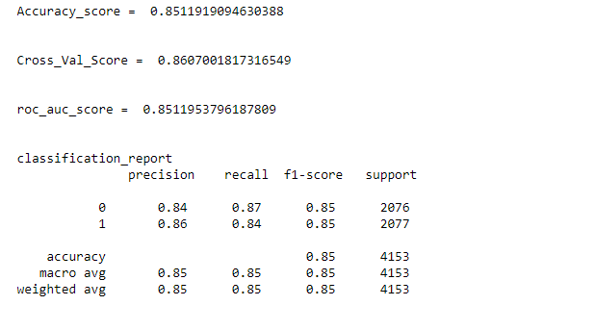
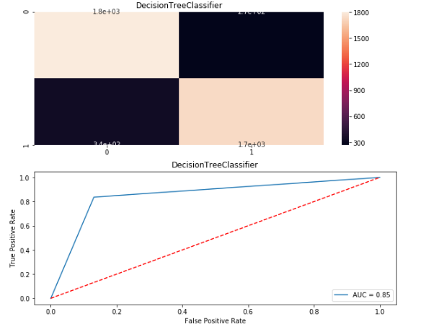
MODEL/S DEVELOPMENT AND EVALUATION
Decision Tree Classifier Visualization:

Slide 11
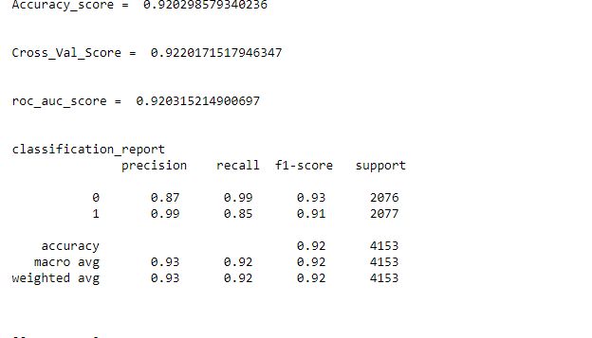
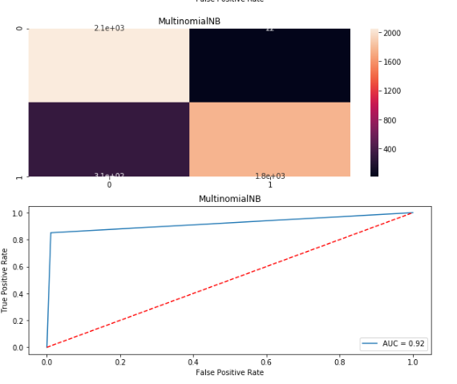
MODEL/S DEVELOPMENT AND EVALUATION
MultiNomial NB Visualization:

Slide 12
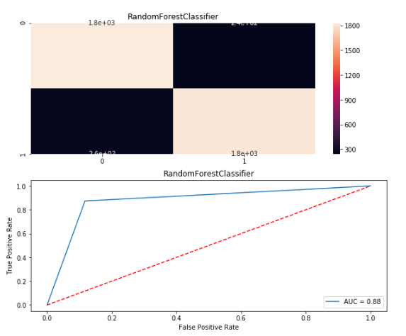
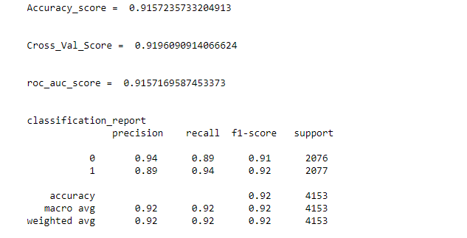
MODEL/S DEVELOPMENT AND EVALUATION
Random Forest Classifier Visualization:

Slide 13
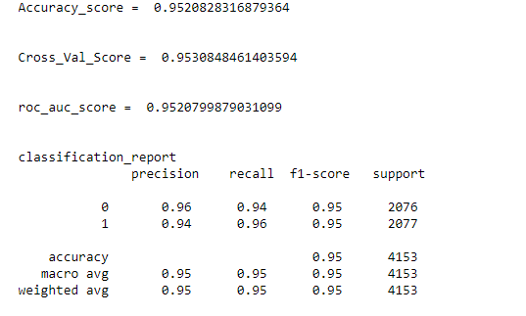
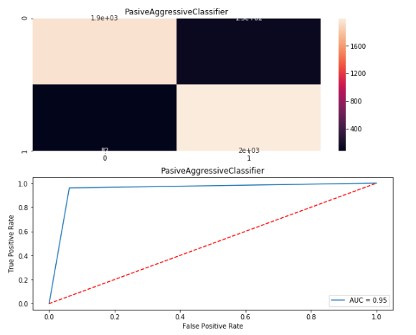
MODEL/S DEVELOPMENT AND EVALUATION
Passive Aggressive Classifier

Slide 14
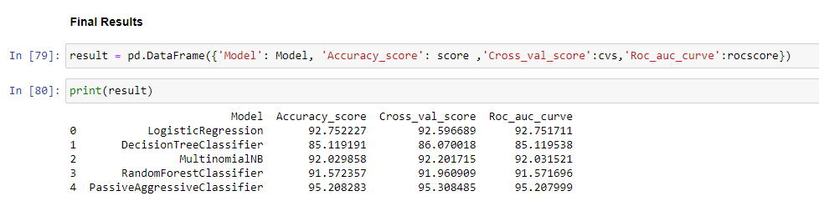
Final model
Hence, the best model for Fake News Detection is PassiveAggressiveClassifier as it has Accuracy_score of 95.20 | Cross_val_score of 95.30 | Roc_auc_curve of 95.2

Slide 15
CONCLUSION
Key Findings and Conclusions of the Study
In the above dataset every features of the dataset plays an important role to understand the data also in visualization and applying models and algorithms.
Learning Outcomes of the Study in respect of Data Science
Visualization is very helpful and it plays a vital role to understand the data into graphical form. So, that we can understand what the data is trying to say.
Data cleaning is also import part it helps me to remove null, nan or missing values by using mean, median, mode or by simply using 0.
I used five types of algorithm like LogisticRegression, DecisionTreeClassifier, MultinomialNB, RandomForestClassifier and PasiveAggressiveClassifier.
The problem I faced while on this dataset is it takes more than one hour for output. I overcome this situation with the help of towardsdatascience.com by running the code using small chunk of dataset to complete the project.

